Slide 1



Human Computer Interaction : Facial Landmarks & Heatmaps
By : Moamen Zaher

Slide 2



How Many Types of Interactions ?
Human – Human
Computer – Computer
Human – Computer
Computer - Human

Slide 3


Interactions

Slide 4
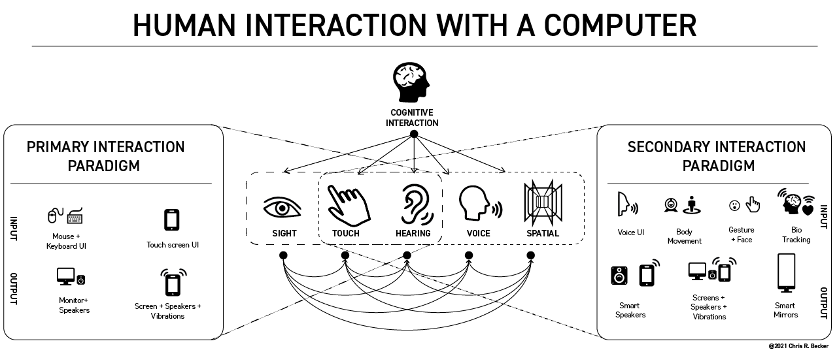

Slide 5
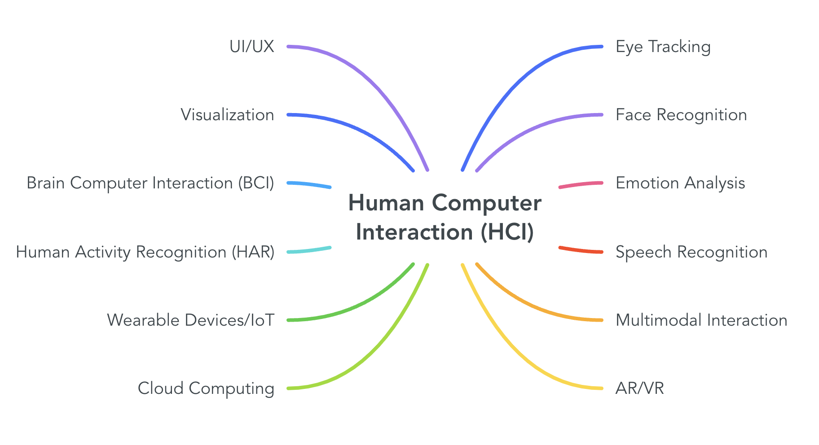
What are the sub-categories of HCI ?
✅
✅
✅
✅
✅
⏳
✅

Slide 6

General Guidelines
Lab is organized as following :
5~10 Minutes intro and history
5 minutes objectives and demos
5~10 minutes discussions
50 minutes for implementation
Attendance is a MUST.
Avoid Being Late.

Slide 7

General Guidelines
Project (25)
Phase I (10)
Phase II (15)
Lab Participation (5)
Quizzes (10)
Lab Quiz (5)
Lecture Quiz (5)
Extras:
Kahoot
Paper submission will also be considered

Slide 8
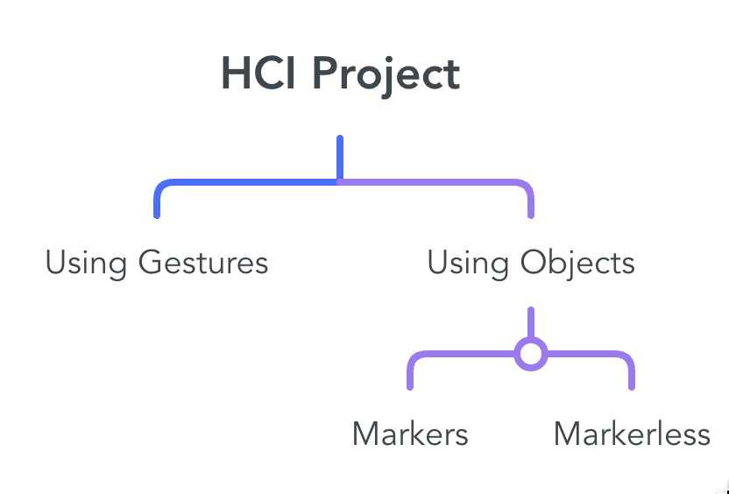
Project
Compare 3 different Interaction Techniques.
Evalute the techniques based on:
User Satisifaction
Engagement
Usability
Surveys

Slide 9


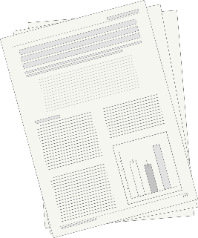

Rewards
Best 2 projects participate in DeepMinds
Best project gets 25 marks
We will dedicate a LinkedIn post for the top project
Members of best 2 projects will receive a recommendation on LinkedIn
You can compete in national competitions with your project
Projects can easily be converted into a scientific paper and have higher chance of acceptance in Journals
Multimodality is booming
Journal publication opens lots of doors abroad

Slide 10

UGRF – CIS: Evaluating Student Engagement

Slide 11
Roadm Map
Week 1
Week 2
Week 3
Week 4
Week 5
Markers TUIO
TUIO + GUI
Sockets
Bluetooth + Context Awareness
Mediapipe + Gesture Recognition
Week 6
Face Detection and Facial Recognition
Week 9
Object Detection YOLO
Week 10
Emotion + Gaze Tracking
Week 11
Unity
Week 12
AR
Quiz
Quiz
Quiz
Quiz

Slide 12









Softwares

Slide 13

Content
Facial Landmarks
Heatmap

Slide 14
Critical Thinking
What is the problem ?
What are the proposed solutions ?
How to implement these solutions ?

Slide 15
Critical Thinking
What is Facial Landmark ?
What is gaze tracking ?
What is heatmaps?

Slide 16
Facial Landmark
a computer vision task that involves detecting and localizing specific points or landmarks on a face, such as the eyes, nose,… etc
Popular Libraries:
OpenCV
Dlib
MTCNN

Slide 17
Installation
On Windows
Install C++ pack (usually installed with Visual Studio “not VS Code”)
Install CMake
Install Dlib

Slide 18
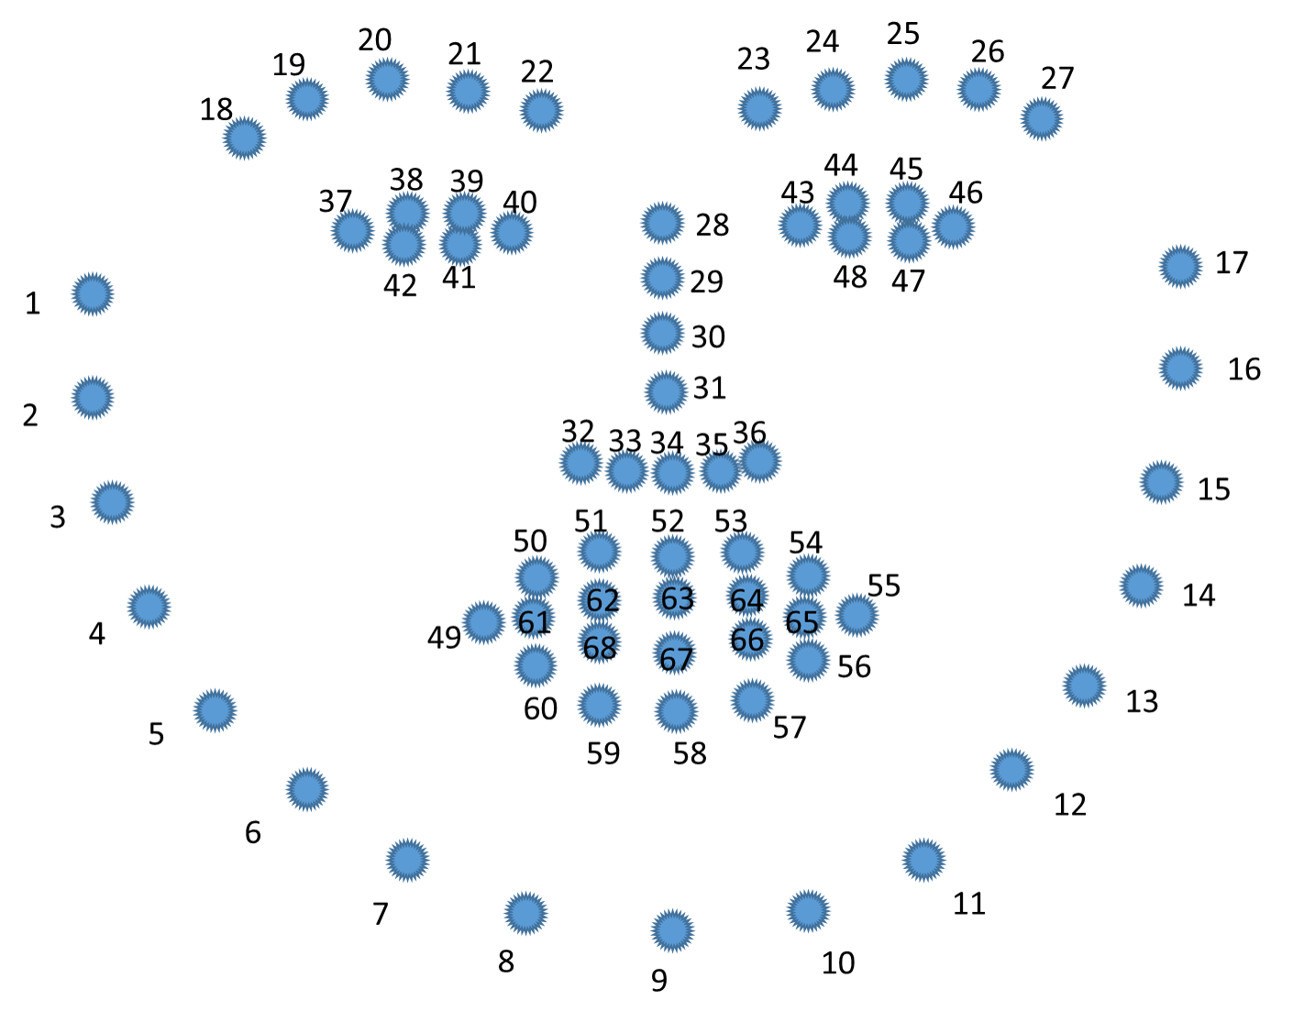
Facial Landmark

Slide 19
Applications of Facial Landmark Detection
Head pose estimation
Deep fake
Emotion Detection
Facial morphing
Gaze tracking

Slide 20
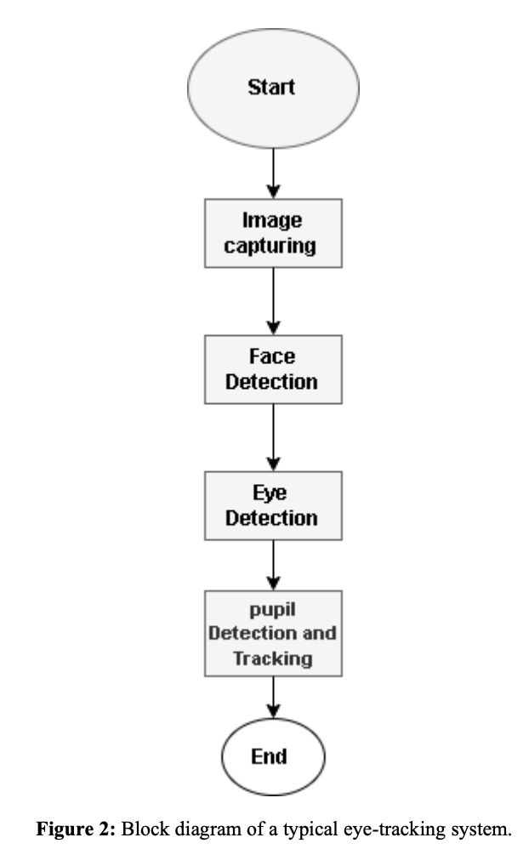
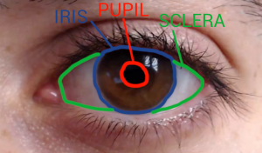
Gaze Tracking
detect a person's presence and follow what they are looking at in real-time.
Alshammari, B., & Jasim, H. (2023). Eye Movement Tracking Using Opencv Python. Wasit Journal of Engineering Sciences, 11(2), 71-81.

Slide 21
https://github.com/sho-87/webcam-eye-tracker/tree/master

Slide 22
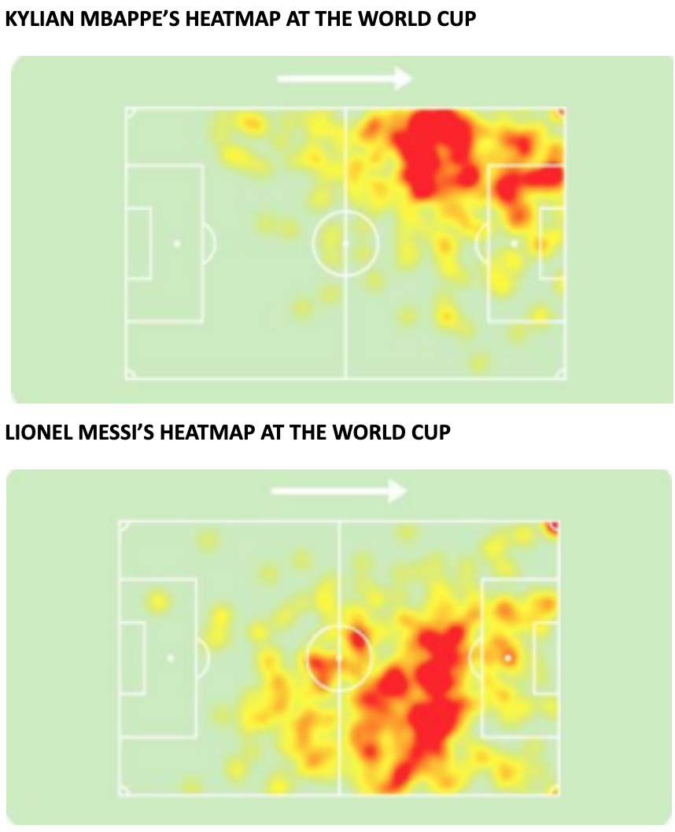
Heatmaps
A heat map is a two-dimensional representation of data in which various values are represented by colors.

Slide 23
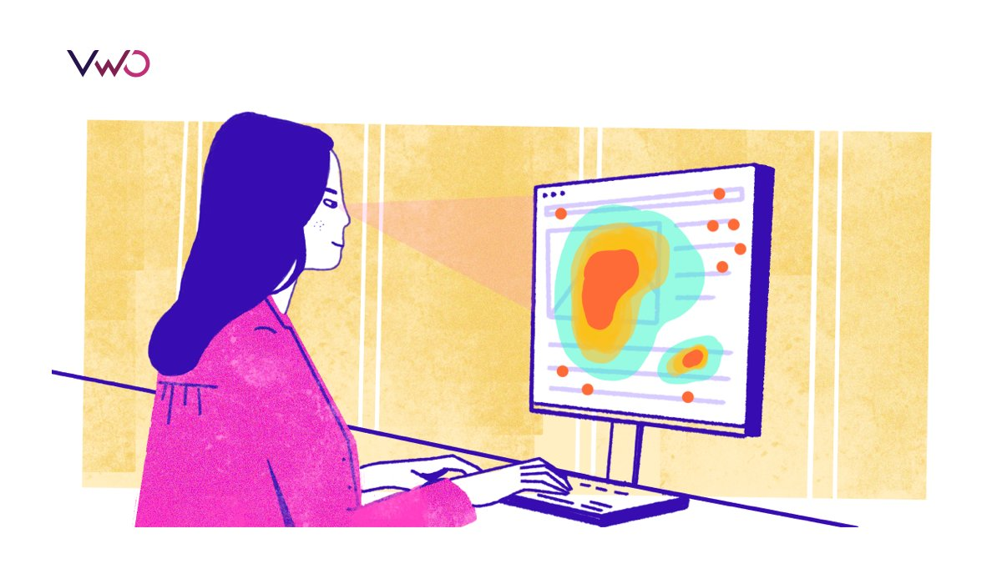

Slide 24
Why Eye Gaze Heatmaps?

Slide 25

Do You Have Any Question ?
Email
fdarwish@msa.edu.eg
maashraf@msa.edu.eg
akamaleldin@msa.edu.eg
maabdelfattah@msa.edu.eg

